Slide 1


Code Edit
Project

Slide 2
Acknowledgement
It gives us great pleasure to present the synopsis of the B.Tech mini project (Study Material) undertaken during B. Tech III Year. This project is going to be an acknowledgment of the inspiration, drive, and technical assistance that will be contributed to it by many individuals. We owe a special debt of gratitude to Mr. Mayank Saxena (Technical Trainer Department of CEA), for providing us with an encouraging platform to develop this project, which thus helped in shaping my abilities towards a constructive goal, through his constant support and guidance to our work. We also do not like to miss the opportunity to acknowledge the contribution of all department faculty members for their kind guidance and cooperation. By: Kaustubh Dubey (201500332), Kaustubh Yadav(201500333), Binayak Singh(201500195), Saksham Gangwar(201500603),Shreyash Varshney(201500675).

Slide 3
Introduction
Our Project “Code Edit” is a web application which is built using multiple web technologies. The primary technology used in creating our project is (React, Node.js) stack.
A code editor is a software tool that is used by programmers to write and edit code. It is a critical tool in the software development process because it helps developers create and maintain software applications. A good code editor provides a range of features and functionality that can make coding more efficient and effective.

Slide 4
Motivation
The “Code Edit” has been developed to solve the problems of code to provide the platform where they can develop and deploy website and programming. There are several motivations for creating a Code Editor Project i.e.
Syntax highlighting: This is a feature that highlights different parts of code based on their function. For example, variables, keywords, and comments may all be highlighted in different colors.
Code completion: This is a feature that suggests code completions as a programmer types, based on the language and context.
Multiple User: This is a feature that allows programmers to make changes to multiple parts of code simultaneously.

Slide 5
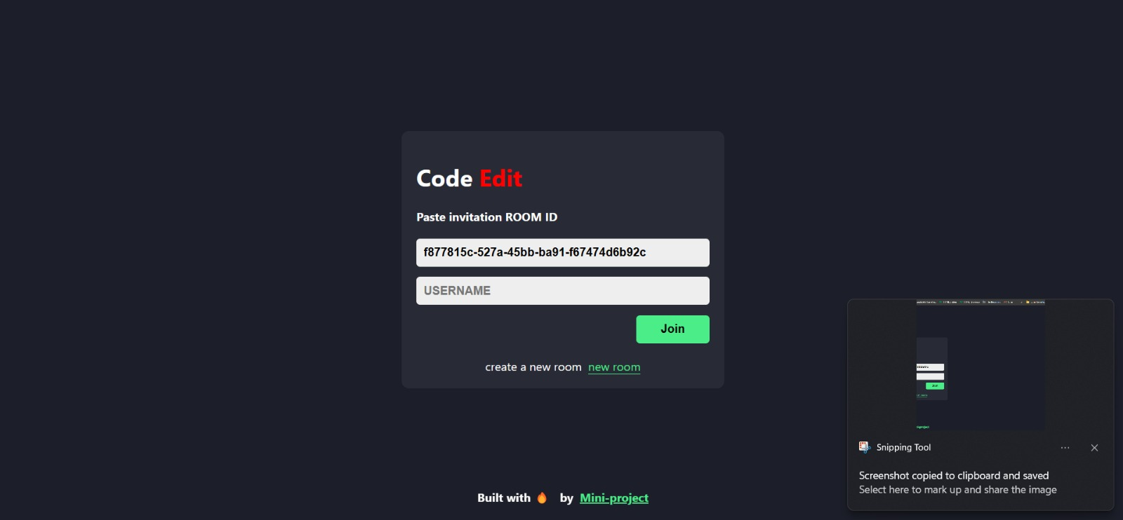
Login Page

Slide 6
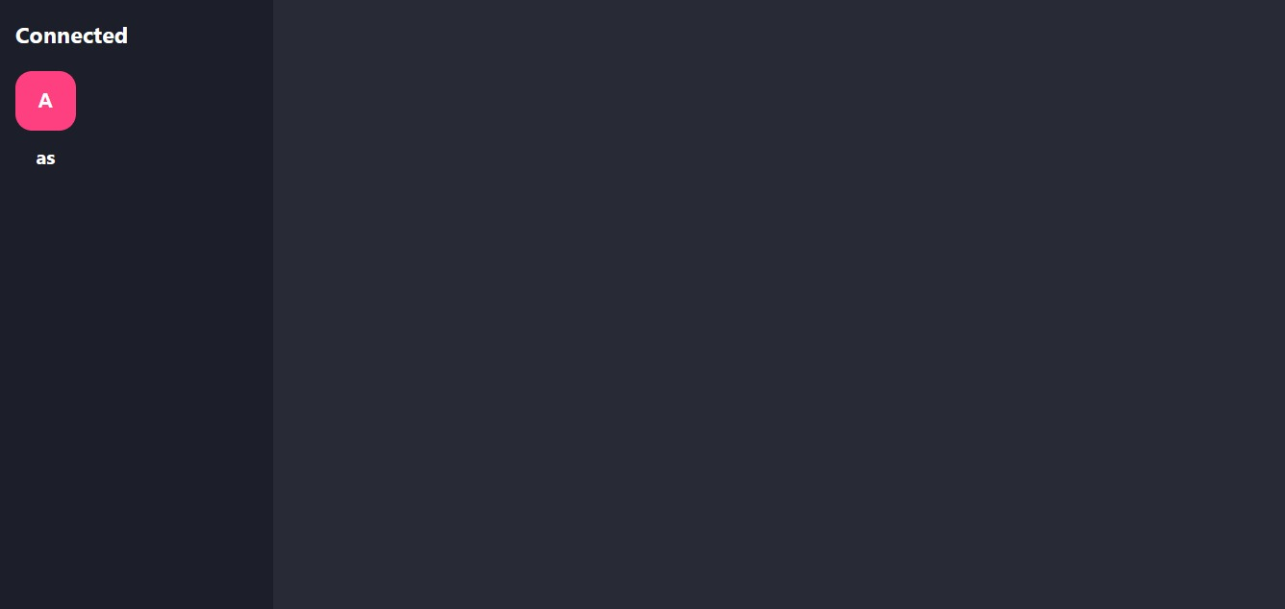
Connected User

Slide 7
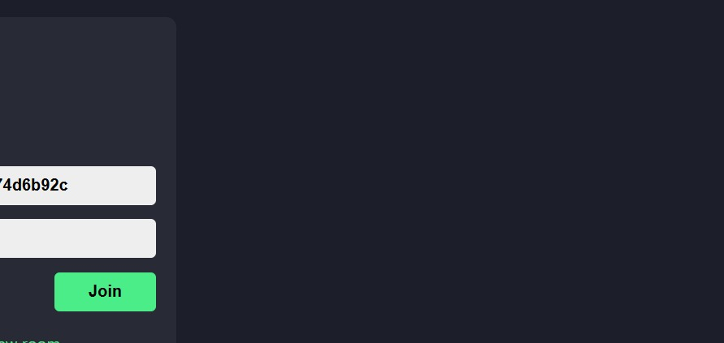
Join Button

Slide 8
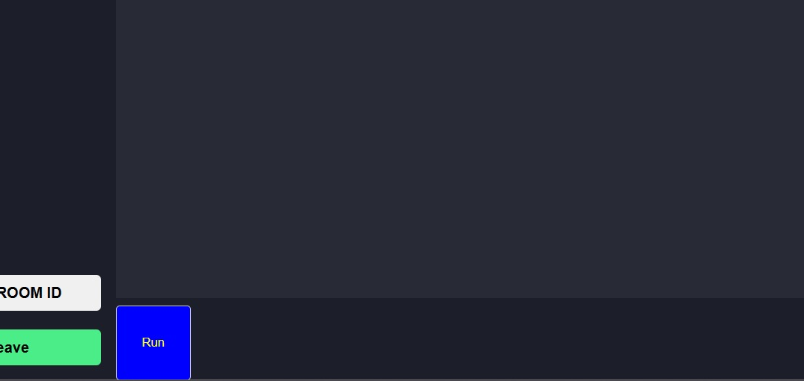
Run Button

Slide 9


THANKS

